Slide 1
Linear Regression
Eric Harley
XBUS 504 – Fall 2018
GSCS

Slide 2
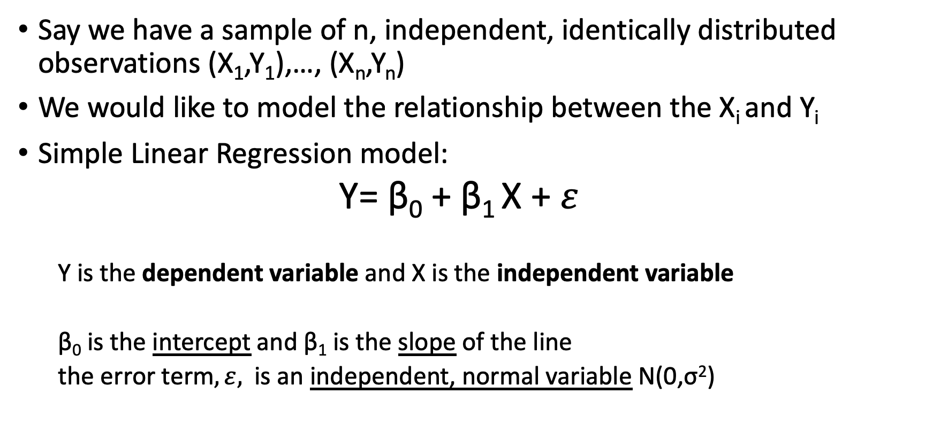
Linear Regression
Say we have a sample of n, independent, identically distributed observations (X₁,Y₁),…, (X_{n},Y_{n})
We would like to model the relationship between the X_{i} and Y_{i}
Simple Linear Regression model:
Y= β₀ + β₁ X + $ε$
Y is the dependent variable and X is the independent variable
β₀ is the intercept and β₁ is the slope of the line
the error term$, ε,$ is an independent, normal variable N(0,σ²)

Slide 3
Regression vs. Correlation Analysis
Why do we need regression? Can we just use correlations to measure the association?
Correlation tells how closely two variables “track” one another.
Regression provides information about predicting Y from X.
Can have low correlation yet significant predictive association!

Slide 4
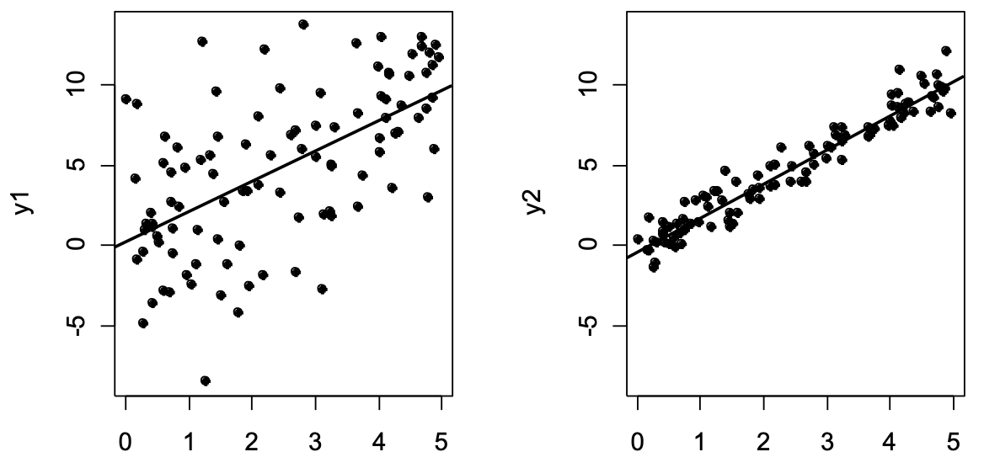
Example: Same slope, different correlation
r = 0.46, b1=2
r = 0.95, b1=2

Slide 5
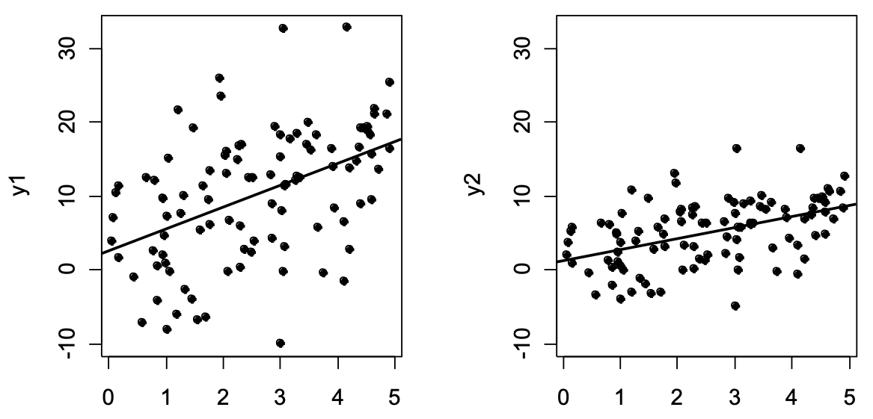
Example: Same correlation, different slope
r = 0.46, b1=4
r = 0.46, b1=2

Slide 6
Linear Regression as Optimization
Total variation is made up of two parts:
Total Sum of Squares
Regression Sum of Squares
Error Sum of Squares
where:
= Mean value of the dependent variable
Y_{i} = Observed values of the dependent variable
_{i} = Predicted value of Y for the given X_{i} value
Residual

Slide 7
Coefficient of Determination, r²
The coefficient of determination is the portion of the total variation in the dependent variable that is explained by variation in the independent variable
The coefficient of determination is also called r-squared and is denoted as r²

Slide 8
Standard Error of Estimate
The standard deviation of the variation of observations around the regression line is estimated by
Where
SSE = error sum of squares
n = sample size

Slide 9
Comparing Standard Errors
S_{YX} is a measure of the variation of observed Y values from the regression line
Y
Y
X
X
The magnitude of S_{YX} should always be judged relative to the size of the Y values in the sample data

Slide 10
House Price and Square Feet
Open House Example Notebook.
Perform Regression
What are the outputs?

Slide 11
Interpretation of β₁
β₁ measures the mean change in the average value of Y as a result of a one-unit change in X
Here, β₁ = .10977 tells us that the mean value of a house increases by .10977($1000) = $109.77, on average, for each additional one square foot of size

Slide 12
Interpretation of β₀
β₀ is the estimated mean value of Y when the value of X is zero
Because the square footage of the house cannot be 0, the Y intercept has no practical application.

Slide 13
Making Predictions
Predict the price for a house with 2000 square feet:
The predicted price for a house with 2000 square feet is 317.85($1,000s) = $317,850

Slide 14
Making Predictions
When using a regression model for prediction, only predict within the relevant range of data
Relevant range for interpolation
Do not try to extrapolate beyond the range of observed X’s

Slide 15
Residual Analysis
The residual for observation i, e_{i}, is the difference between its observed and predicted value
Check the assumptions of regression by examining the residuals
Linearity
Independence
Normality
Equal variance
Graphical Analysis of Residuals
Plot residuals vs. X

Slide 16
Residual Analysis for Linearity
Y
Y
x
x
residuals
x
x
residuals
Not Linear
✓
Linear

Slide 17
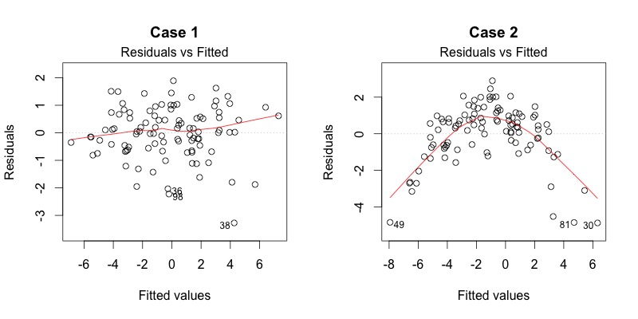
Residual Analysis for Linearity
lm(weight ~ height, women)

Slide 18
Residual Analysis for Independence
Not Independent
✓
Independent
residuals
X
residuals
X
residuals
X

Slide 19
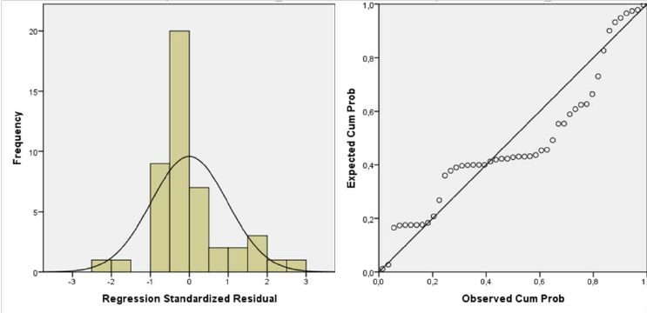
Checking for Normality

Slide 20
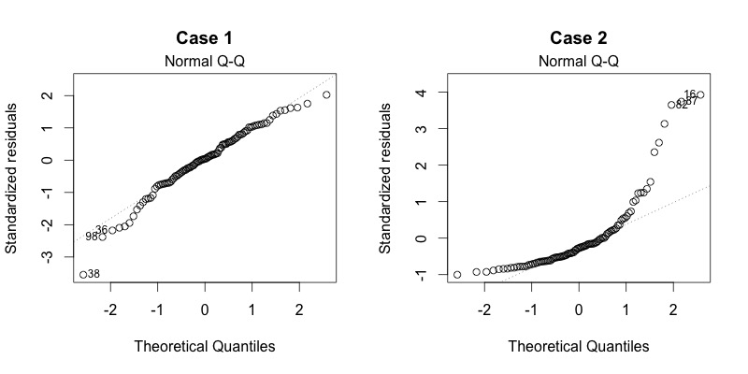
Checking for Normality
lm(weight ~ height, women)

Slide 21
Residual Analysis for Homoscedasticity
Y
Y
x
x
residuals
x
x
residuals
✓
Non-constant variance
Constant variance

Slide 22
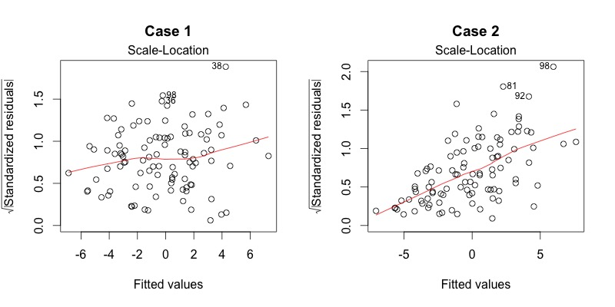
Residual Analysis for Homoscedasticity
lm(weight ~ height, women)

Slide 23
Example Residual Plot
RESIDUAL OUTPUT
 | Predicted House Price | Residuals
1 | 251.92316 | -6.923162
2 | 273.87671 | 38.12329
3 | 284.85348 | -5.853484
4 | 304.06284 | 3.937162
5 | 218.99284 | -19.99284
6 | 268.38832 | -49.38832
7 | 356.20251 | 48.79749
8 | 367.17929 | -43.17929
9 | 254.6674 | 64.33264
10 | 284.85348 | -29.85348

Slide 24
Leverage and Influence
Leverage is a function of the explanatory variable(s) alone and measures the potential for a data point to affect the model parameter estimates.
Influence is a measure of how much a data point actually does affect the estimated model.

Slide 25
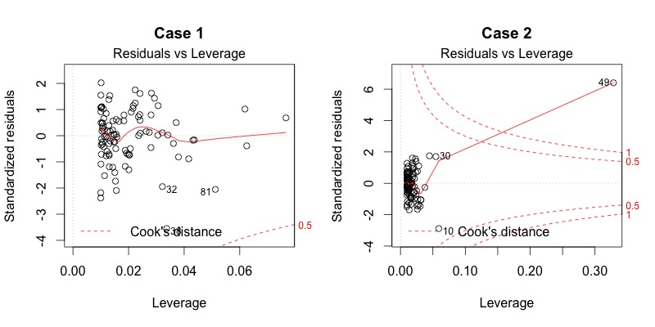
Leverage and Influence
lm(weight ~ height, women)

Slide 26
Avoiding the Pitfalls of Regression
Start with a scatter plot of X on Y to observe possible relationship
Perform residual analysis to check the assumptions
Plot the residuals to check for violations of assumptions
Use a histogram, box plot, or normal probability plot of the residuals

Slide 27
Avoiding the Pitfalls of Regression
If there is violation of any assumption, use alternative methods.
If there is no evidence of assumption violation, then test for the significance of the regression coefficients and construct confidence intervals and prediction intervals.
Avoid extrapolating outside the range of your data.

Slide 28
Inferences About the Slope: t Test
t test for a population slope
Is there a linear relationship between X and Y?
Null and alternative hypotheses
H₀: β₁ = 0 (no linear relationship)
H₁: β₁ ≠ 0 (linear relationship does exist)

Slide 29
t Test Example
 | Coefficients | Standard Error | t Stat | P-value
Intercept | 98.24833 | 58.03348 | 1.69296 | 0.12892
Square Feet | 0.10977 | 0.03297 | 3.32938 | 0.01039
Test Statistic: t = 3.329
H₀: β₁ = 0
H₁: β₁ ≠ 0
d.f. = 10- 2 = 8
Decision: Reject H₀
α/2=.025
α/2=.025
There is sufficient evidence that square footage affects house price
Reject H₀
Do not reject H₀
Reject H₀
-t_{α/2}
t_{α/2}
0
-2.3060
2.3060

Slide 30
Regression with Statsmodels

Slide 31
import pandas as pd
import statsmodels.formula.api as smf
df = pd.read_csv(’https://bit.ly/2HVXWqR', index_col=0)
est = smf.ols(formula='Employed ~ GNP', data=df).fit()
est.summary()

Slide 32
Dep. Variable | Which variable is the response in the model
Model | What model you are using in the fit
Method | How the parameters of the model were calculated
No. Observations | The number of observations (examples)
DF Residuals | Degrees of freedom of the residuals. Number of observations - number of parameters
DF Model | Number of parameters in the model (not including the constant term if present)

Slide 33
R-squared | The coefficient of determination. A statistical measure of how well the regression line approximates the real data points
Adj. R-squared | The above value adjusted based on the number of observations and the degrees-of-freedom of the residuals
F-statistic | A measure how significant the fit is. The mean squared error of the model divided by the mean squared error of the residuals
Prob (F-statistic) | The probability that you would get the above statistic, given the null hypothesis that they are unrelated
Log-likelihood | The log of the likelihood function.
AIC | The Akaike Information Criterion. Adjusts the log-likelihood based on the number of observations and the complexity of the model.

Slide 34
coef | The estimated value of the coefficient
std err | The basic standard error of the estimate of the coefficient. More sophisticated errors are also available.
t | The t-statistic value. This is a measure of how statistically significant the coefficient is.
P > |t| | P-value that the null-hypothesis that the coefficient = 0 is true. If it is less than the confidence level, often 0.05, it indicates that there is a statistically significant relationship between the term and the response.
[95.0% Conf. Interval] | The lower and upper values of the 95% confidence interval

